Slide 1

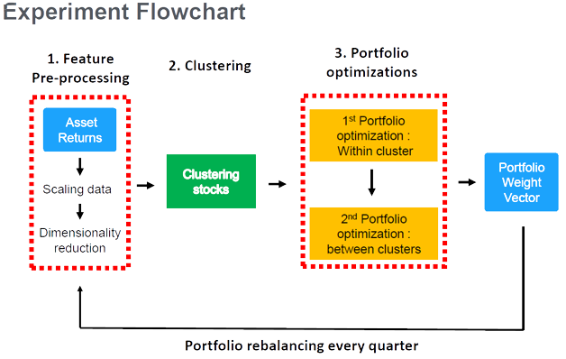
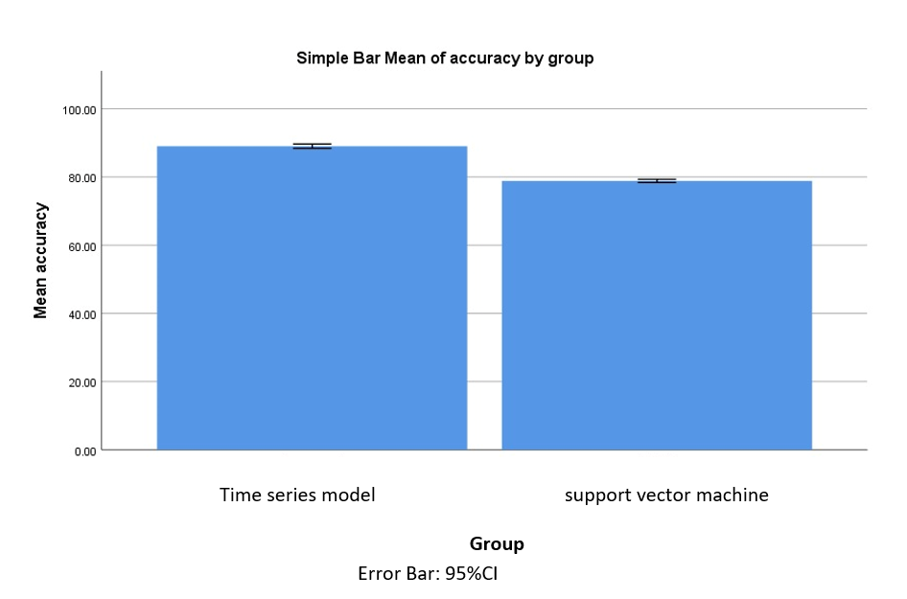
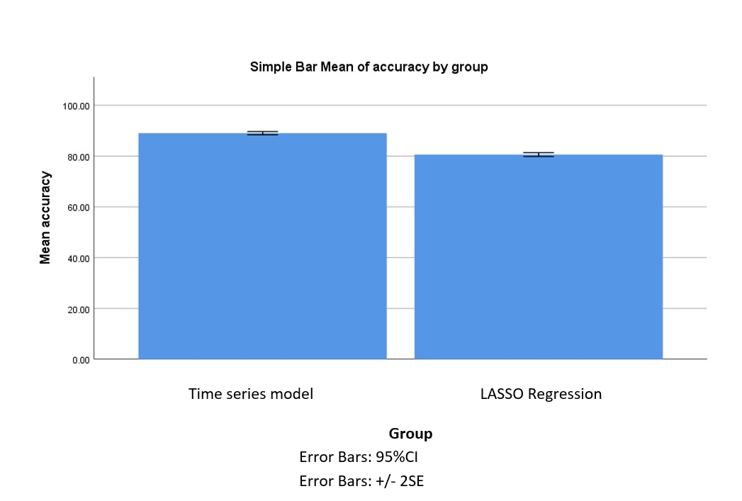
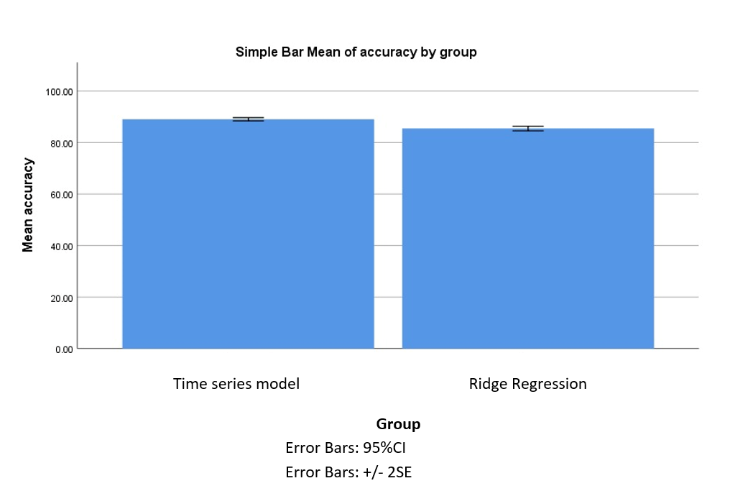
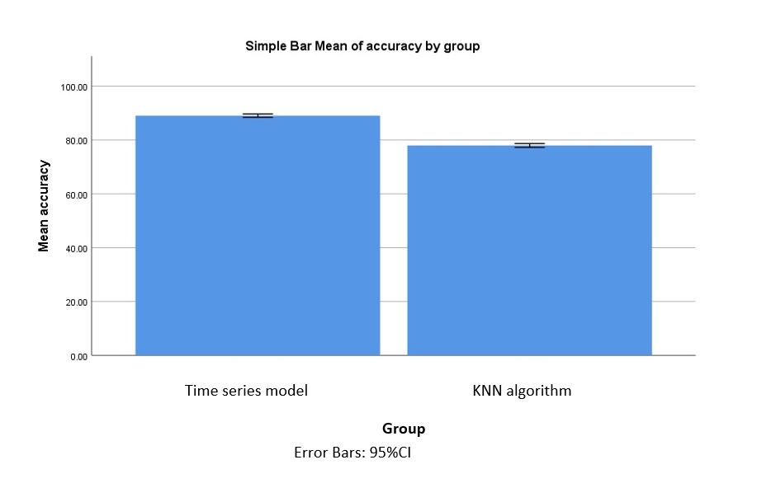
K. Sravan
Guided By Dr. P. Sriramya
Portfolio optimization with Time Series Model using Modern Portfolio Theory compared with other Machine Learning Algorithms with improved accuracy
INTRODUCTION
Portfolio optimization is a crucial area of research in finance, aimed at constructing investment portfolios that maximize returns while minimizing risks.
Portfolio optimization is the process of selecting the best combination of assets, considering their risk and return characteristics, in order to achieve an investor's desired level of return for a given level of risk.
Traditional portfolio optimization algorithms rely on statistical methods that have limitations in handling time-varying market conditions.
To overcome these limitations, time series models have been developed that can capture the dynamics of asset prices over time.
In addition, a novel modern portfolio theory has been developed that incorporates machine learning techniques to overcome the limitations of traditional portfolio optimization algorithms.
MATERIALS AND METHODS
RESULTS
Statistical Analysis
TSM Vs SVM
TSM Vs LASSO Regression
TSM Vs Ridge Regression
TSM Vs KNN Algorithm
The accuracy of Time series algorithm(94.2820%) are high compared to Support Vector Machine (78.9570%), Lasso regression(80.1423%), Ridge regression(86.2364%), KNN algorithm(76.9854) Significance of the accuracy.
DISCUSSION AND CONCLUSION
The independent sample t-test has a significance value p=0.000(p<0.05) indicating the study between the Time Series Model and the other machine learning algorithm’s is statistically significant.
In this research work, the results shown us is that the Time Series Model with Modern Portfolio Theory can be used for the prediction of stock market with an accuracy of 94.28%
The Novel Time Series Model method performs better than the all other four algorithms in Accurate(94.28%) in prediction of stock.
As a future work the study can be extended to include other asset classes such as fixed income, commodities, and currencies. This would provide a more comprehensive analysis of the performance of MPT 2.0 and SVM in Novel Modern Portfolio optimization across different asset classes.
BIBLIOGRAPHY
Fabozzi, F. J., & Focardi, S. M. (2021). Portfolio optimization with machine learning: A new approach to constructing optimal portfolios. John Wiley & Sons.
Lai, T. L., Zhang, Y., & Zhou, Z. (2021). Portfolio optimization with transaction costs: A machine learning approach. Journal of Financial Economics, 139(2), 546-567.
Rehrig, A., Kondor, I., & Papp, G. (2021). Machine learning in asset management: Beyond the hype. Journal of Portfolio Management, 47(4), 1-15.
Wu, P., & Yao, Q. (2020). Robust portfolio optimization with a new regularization method. European Journal of Operational Research, 287(1), 184-197.

